Slide 1
Skill Finder Deployment Flow
Author: Denys Serdiuk
Contact: dserdiuk@bpcs.com

Slide 2
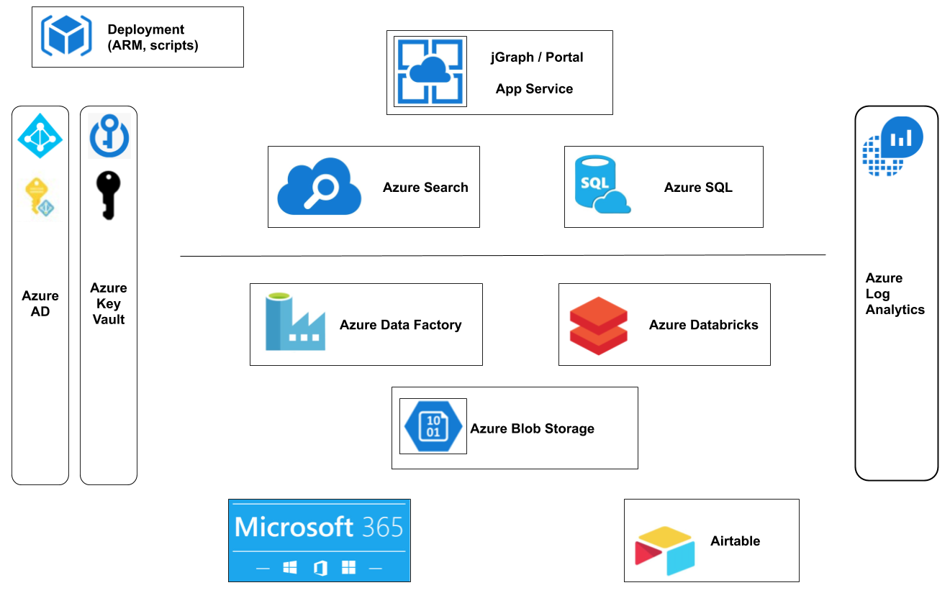
SkillFinder High Level Architecture
Credit: Claudiu Barbura

Slide 3
Deployment tools and dependencies
Python 3.7+
Azure CLI
sqlcmd ( if SQL Server database schema initialization is set to auto mode)
Azure Subscription owned by the deployer
Note:
It’s recommended to deploy from Azure CloudShell Bash. It comes with all required dependencies.

Slide 4
Deployment procedure Overview
Deployment Stages:
Requirements validation: python, sqlcmd, Azure CLI, Azure Quotes, etc.
Prompt the user for critical parameters
Active Directory records initialization ( service principals, app registration, etc.)
mainTemplate.json ARM template deployment
SQL Server schema initialization ( including schema and contained users with permission grants for Service Principals )
Post-deployment step (Databricks cluster provisioning, sampled/simulated data ingestion, Data Factory triggers activation)

Slide 5
Key Concepts
install.sh orchestrates python scripts and runs them in the right order
Python scripts ( install.py, run_db_stage.py, post-deployment.py) use Azure CLI python-binding to execute az commands to perform changes in Azure
Deployment scripts persist the deployment state in the ~/.gdc folder, in order to be able to continue deployment after a failure or interruption (depending on the failed stage)

Slide 6
